Slide 1

ALIGARH MUSLIM UNIVERSITY
ZHCET
E-COMMERCE SHOPPING WEBSITE
AKMAL AHMAD
20COB525
TANZEELUR REHMAN
20COB116
PROJECT UNDER SUPERVISOR
Mr. SAYYED USMAN AHMED

Slide 2
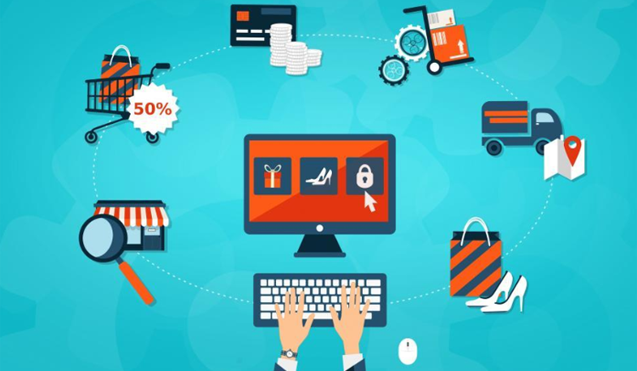
INTRODUCTION
The purpose of this project any person can sell product online. Buying and selling product online by using E Commerce website.
Through an e-commerce website, a business can process orders, accept payments, manage shipping and logistics, and provide customer service.
B2C "business-to-consumer
B2C business-to-consumer ecommerce, also called retail ecommerce, is a business model that involves sales between online businesses and consumers

Slide 3

OBJECTIVE
The primary objective of our B2C e-commerce website is to reach maximum customers at the right time to increase sales and profitability of the business.
For the welfare of community in general Customer find better products during online shopping and save time.
To spread the small scale retails into large level business.
In simple to provide is a big opportunity for small vendors to huge traffic of customers.

Slide 4

MOTIVATION
Customer satisfaction will be improved more.
More offers and discounts will be provided for buyers.
Easy to spread business across countries
Helps to increase our national income.
Quality over quantity. otherwise, quality is equally maintained with quantity.
100% client support
Sellers want to sell their product at an affordable price without unnecessary taxes.

Slide 5
Reasons Why E-Commerce Is Good ?
Bigger market and more customers from the entire globe.
Can do business in any currency can choose with.
Very low overhead of your storefront, hiring and managing employees.
Better Revenue generation.
Remove Destination Barrier.
24/7 Access to Whole Range Of Products

Slide 6

Advantages of Online Shopping
Online shopping is convenient
Often more cheaper.
Bigger variety of products
Location-independent as long as there is an internet connection.
High levels of flexibility.
You can order anytime you want
Easier price comparisons
You don’t have to be in overcrowded stores

Slide 7
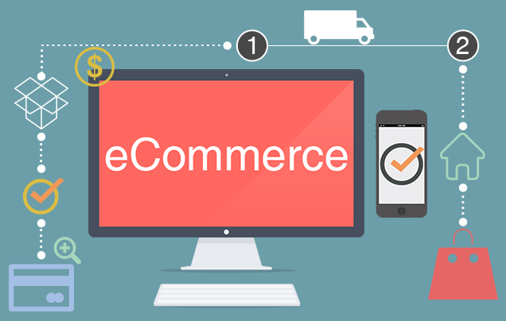
Advantages of Online Shopping
Avoidance of sales staff who wants to market products to you.
You can read plenty of reviews before buying products
You might find better products during your online research
Shopping online can save you plenty of time
Higher chance for discounts and coupons
You can save fuel.
Our Online shopping provides privacy concern during online transition.

Slide 8

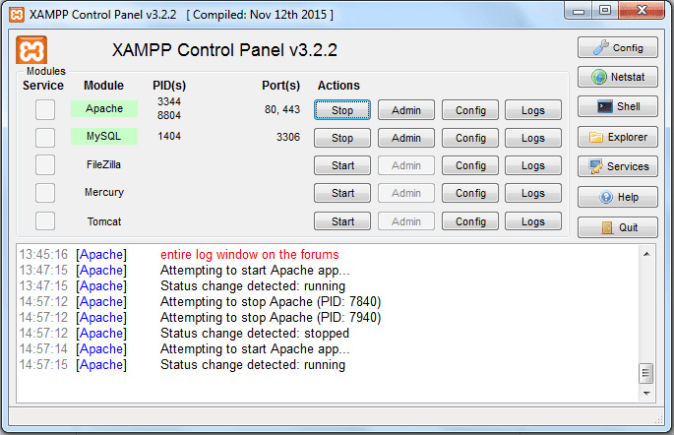

Java ScriptJS is a dynamic computer programming language. It is most commonlyused as part of web browsers, whose implementations allow client-side
Online Shopping System
Department of Computer Science, CUSAT Page 37
scripts to interact with the user, control the browser, communicateasynchronously, and alter the document content that is displayed.Java Script is used to create pop up windows displaying different alerts in
the system like “User registered successfully”, ”Product added to cart” etc
SYSTEM TOOLS
XAMPP Control Panel
Online photo shop
FRONT END DEVELOPMENT :
HTML
CSS
JAVA SCRIPT
BACK END DEVELOPMENT:
The back end is implemented using MySQL which is used to design the databases
This Photo by Unknown Author is licensed under CC BY-NC

Slide 9

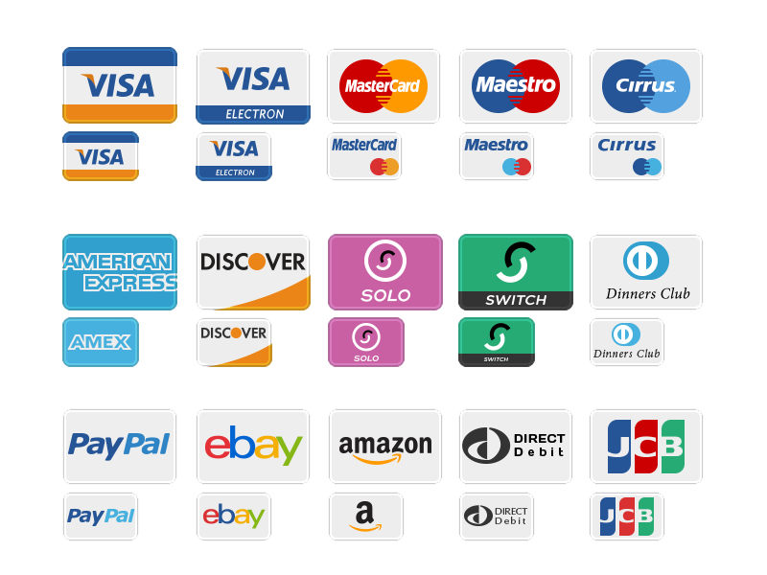
OUR FUTURE AIM
Payment system both domestic and international.
Google map.
Customer support interface.
Resell old product through the our website.

Slide 10
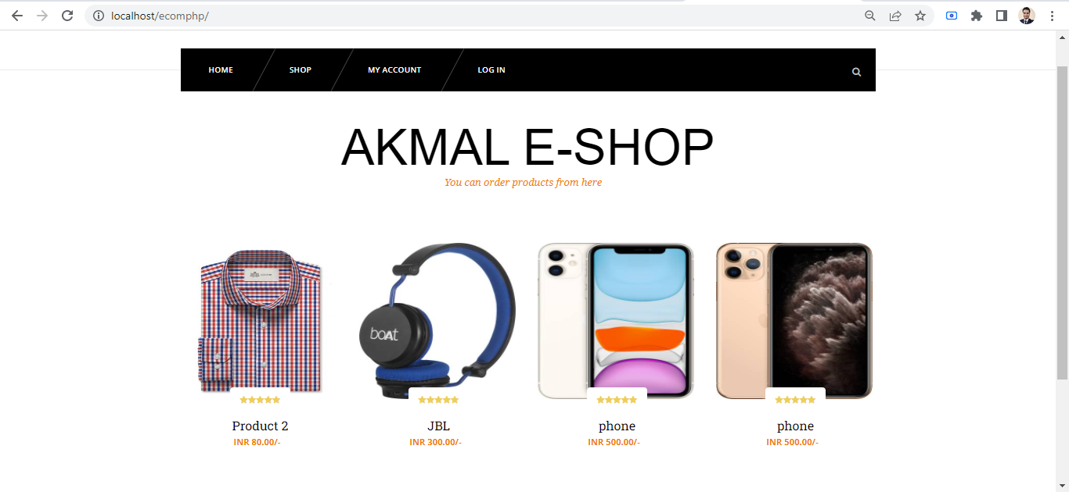
OUR PROJECT OVERVIEW
1. HOME PAGE

Slide 11
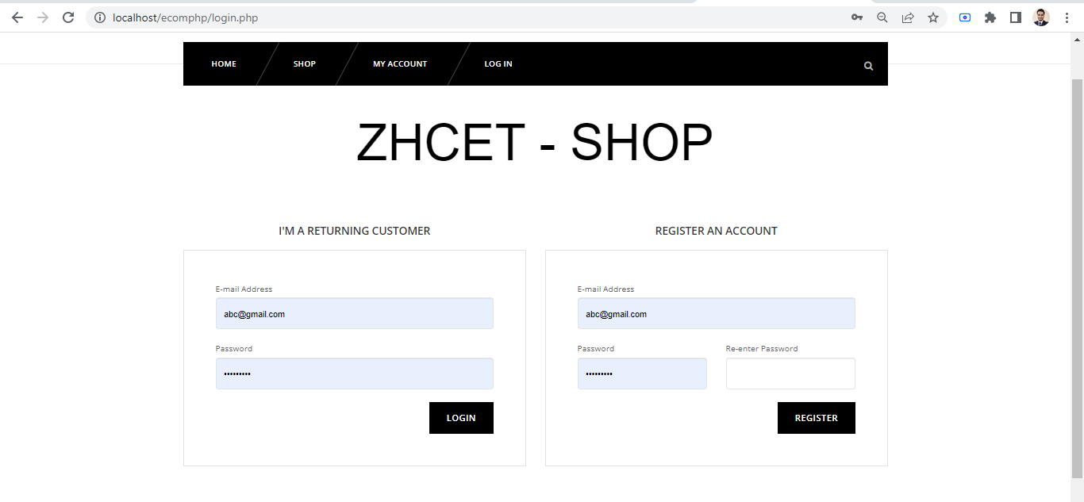
OUR PROJECT OVERVIEW
2. LOGIN PAGE

Slide 12
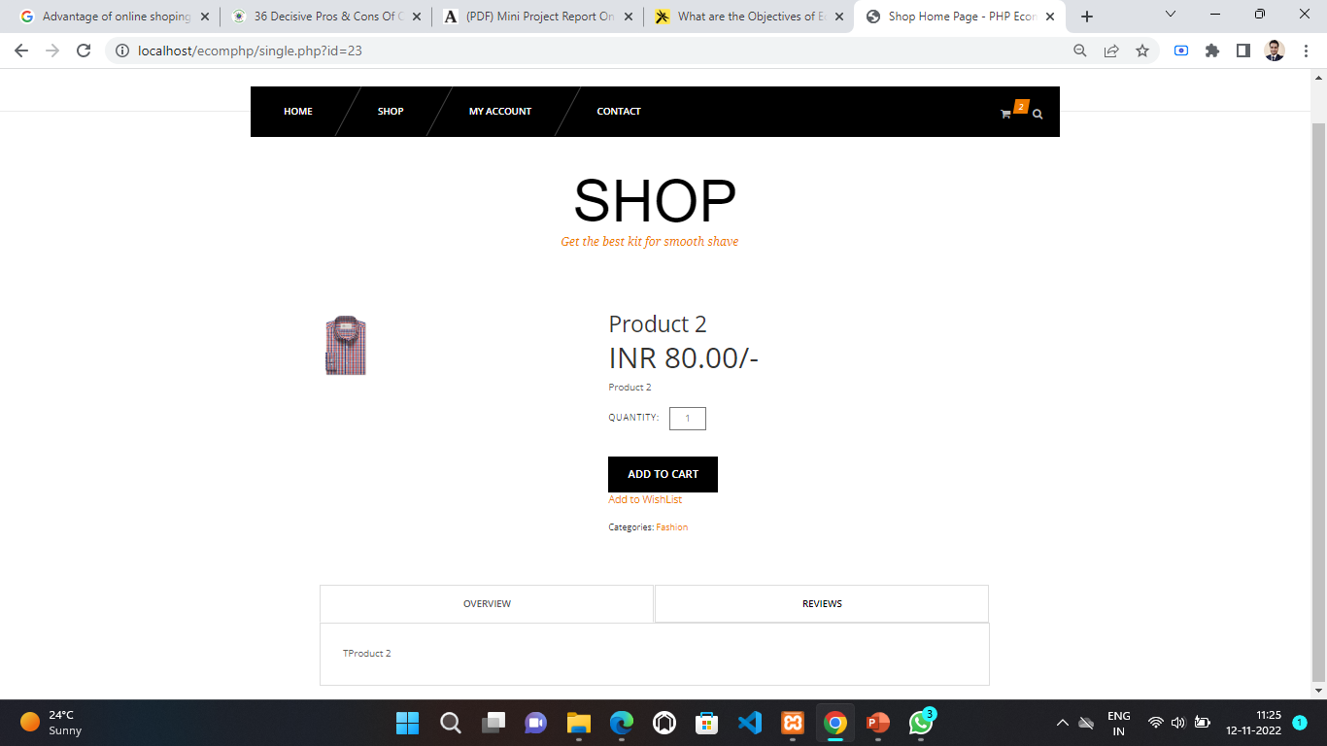
OUR PROJECT OVERVIEW
3. PRODUCT PAGE

Slide 13
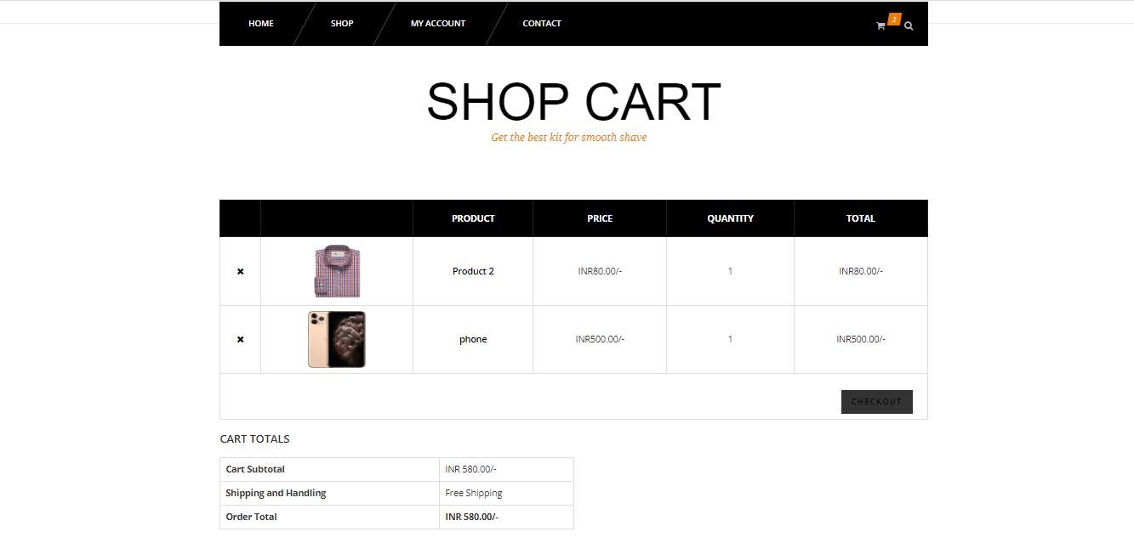
OUR PROJECT OVERVIEW
4. SHOP CART PAGE

Slide 14
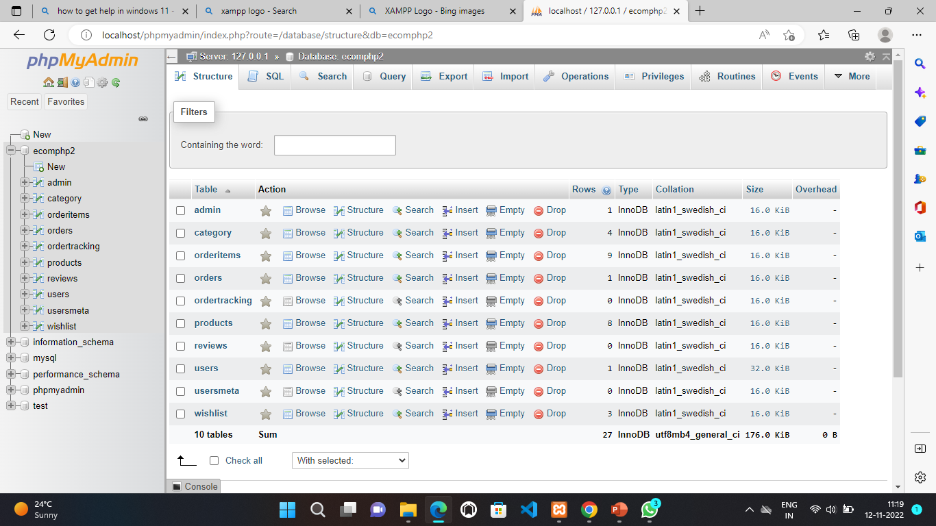
OUR PROJECT OVERVIEW
5. DATABASE PAGE

Slide 15

REFERENCES
https://www.w3schools.com/html/
https://www.tutorialspoint.com/css/index.htm
https://www.ionos.com/digitalguide/server/tools/xampp-tutorial-create-your-own-local-test-server/

